Slide 1
FSSR data analysis (explanation)
„Study of a Titanium wire isochorically heated by laser-accelerated electrons”
P166 – Phelix (GSI), 02-20 April 2018

Slide 2
Part 1
Hot/cold K-alfa analysis - notes

Slide 3
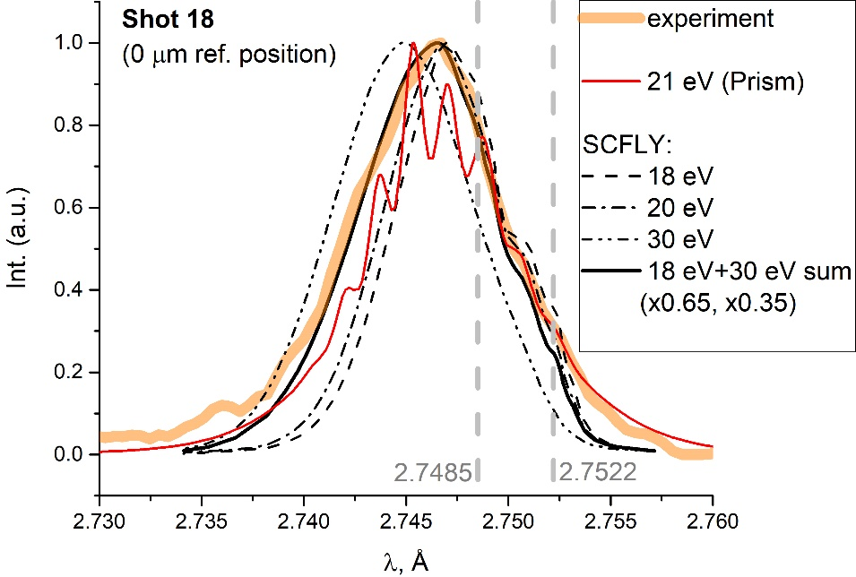
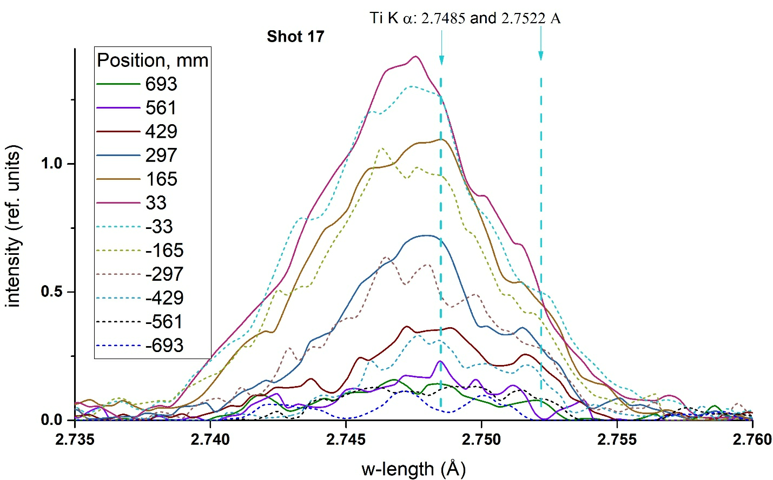
An analysis of the experimental data was made by its comparing with model curves obtained using the SCFLY, PrismSPECT (and MUZE a little) codes.
Some notes:
1. The SCFLY modelling curves were taken from [L. J. Bae et al., Opt. Express, vol. 26, no. 5, p. 6294, 2018.] (the energy of the hot electrons was 0.5 MeV). The curves for energies of 1, 3, 5, 7, 9, 11, 13, 15, 18, 20, 25, 30, 35, 40 eV were used. It was noted that experimental spectra curves can be described usually only as a sum of several model spectra. For example, model spectra curve for 18 eV and 30 eV (in a ratio of 0.65 to 0.35, which is an equivalent to 22.2 eV) describes the experimental spectrum curve for the position of 0 μm shot 18 (see Fig. 1 ).
2. An example of experimental spectral curves of Kα of shot 17 in different relative positions.
The “cold” K_{α} lines (2.7485 Å and 2.7522 Å) were used as main reference lines for the analysis. Its position was estimated by taking into account both peaks position for different spatial positions and profile peculiarities (inclines including) of spectrum. Please note, peak that can be seen between K_{α 1} and K_{α 2} lines (about 2.750 Å) should not be confused with “cold” K_{α} lines.

Slide 4
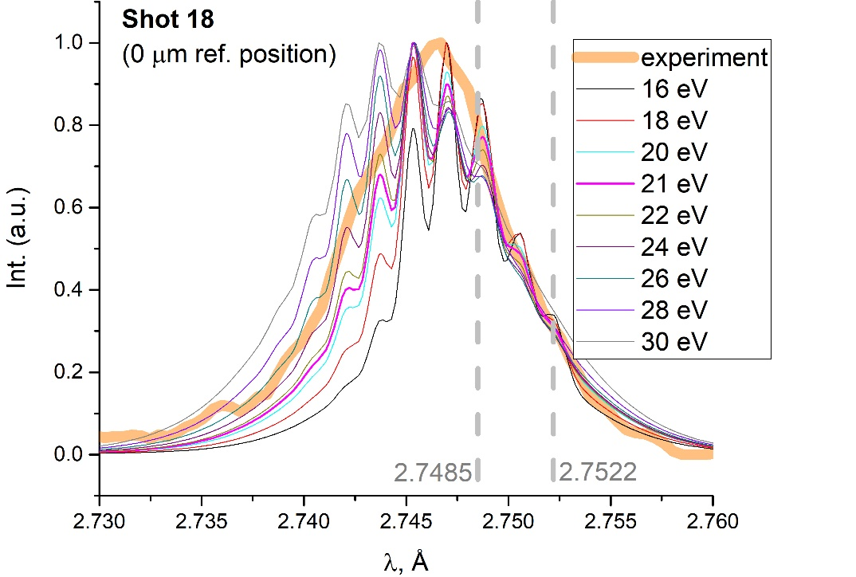
3. Prism spectrum curves were obtained by combining curves for two cases: neglecting and taking into account of Kα inner-shell transitions for a certain number of bound electrons. The obtained curves are in agreement with MUZE code curves (which was used to analyze the previous experiment results). The hot electron temperature was assumed to be 1 MeV.
One can be seen that example special curve is fitted with Prism modelling curve in a relatively narrow range 20-26 eV (with 21 eV best one).
4. The SCFLY and Prism curves are oriented to different parts of the experimental spectrum:
- SCFLY is more oriented to the widths of the experimental spectrum and to a lesser extent on the profile of a tip part of the spectral curves;
- and Prism conversely.
Therefore, two estimated distributions of electron temperature of Ti as a function of width (using SCFLY and using Prism) doesn’t always have the same patterns.
5. The relative intensities of the spectral lines was not taken into account in any way.

Slide 5
Part 2
Hot/cold K-alfa analysis – example (shot 17)

Slide 6
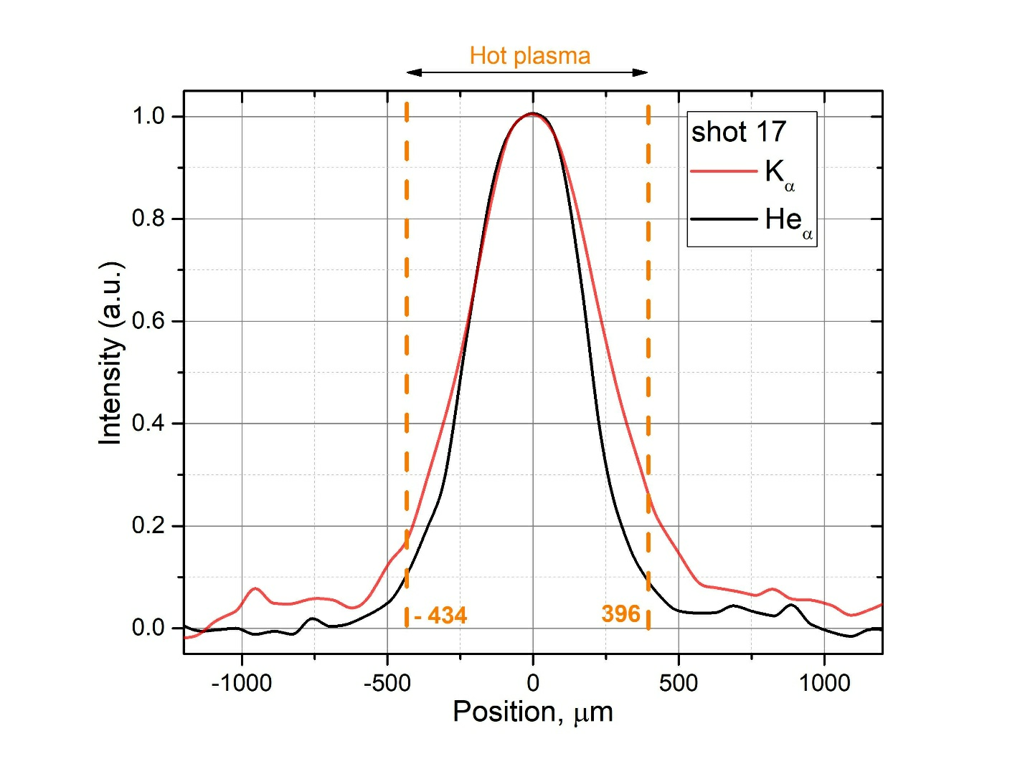
Shot 17.
Spatial distribution - How we can distinguish WDM from hot plasma area is on the picture.
Here is the spatial distribution of the emission traced separately for Hea and Ka groups. First can be used to trace the extend of hot plasma, while latter can be emitted by relatively cold and dense matter states only. Obviously, the extend of Hea is seen much broader, up to 400 aside, than might be expected from the focal spot size. That corresponds to the contribution of the expanding and recombining hot plasma plume at later times, and superimposed to the emission of the wire-target behind.
However, the presence of K_{α} emission near the center position reveals the existence of solid and not too hot (below 100 eV) plasma in this area at some (early) time. The analysis on WDM state can be done considering Ka emission alone, without a reference to the plasma parameters retrieved from Hea, while we do not have a solid claim that considered WDM state is made by hot electron flow only, without preheating by laser radiation (as we could do with shot-to-wire-tip configuration.
Vertical dashed lines indicate the conditional boundary of hot plasma - WDM. It was estimated as 0.1 of He_{α} height (He_{α} is emitted from hot plasma region; K_{α} from both of hot plasma and solid).
Zero position was estimated as a point with maximum of intensity of He_{α} and K_{α}.

Slide 7
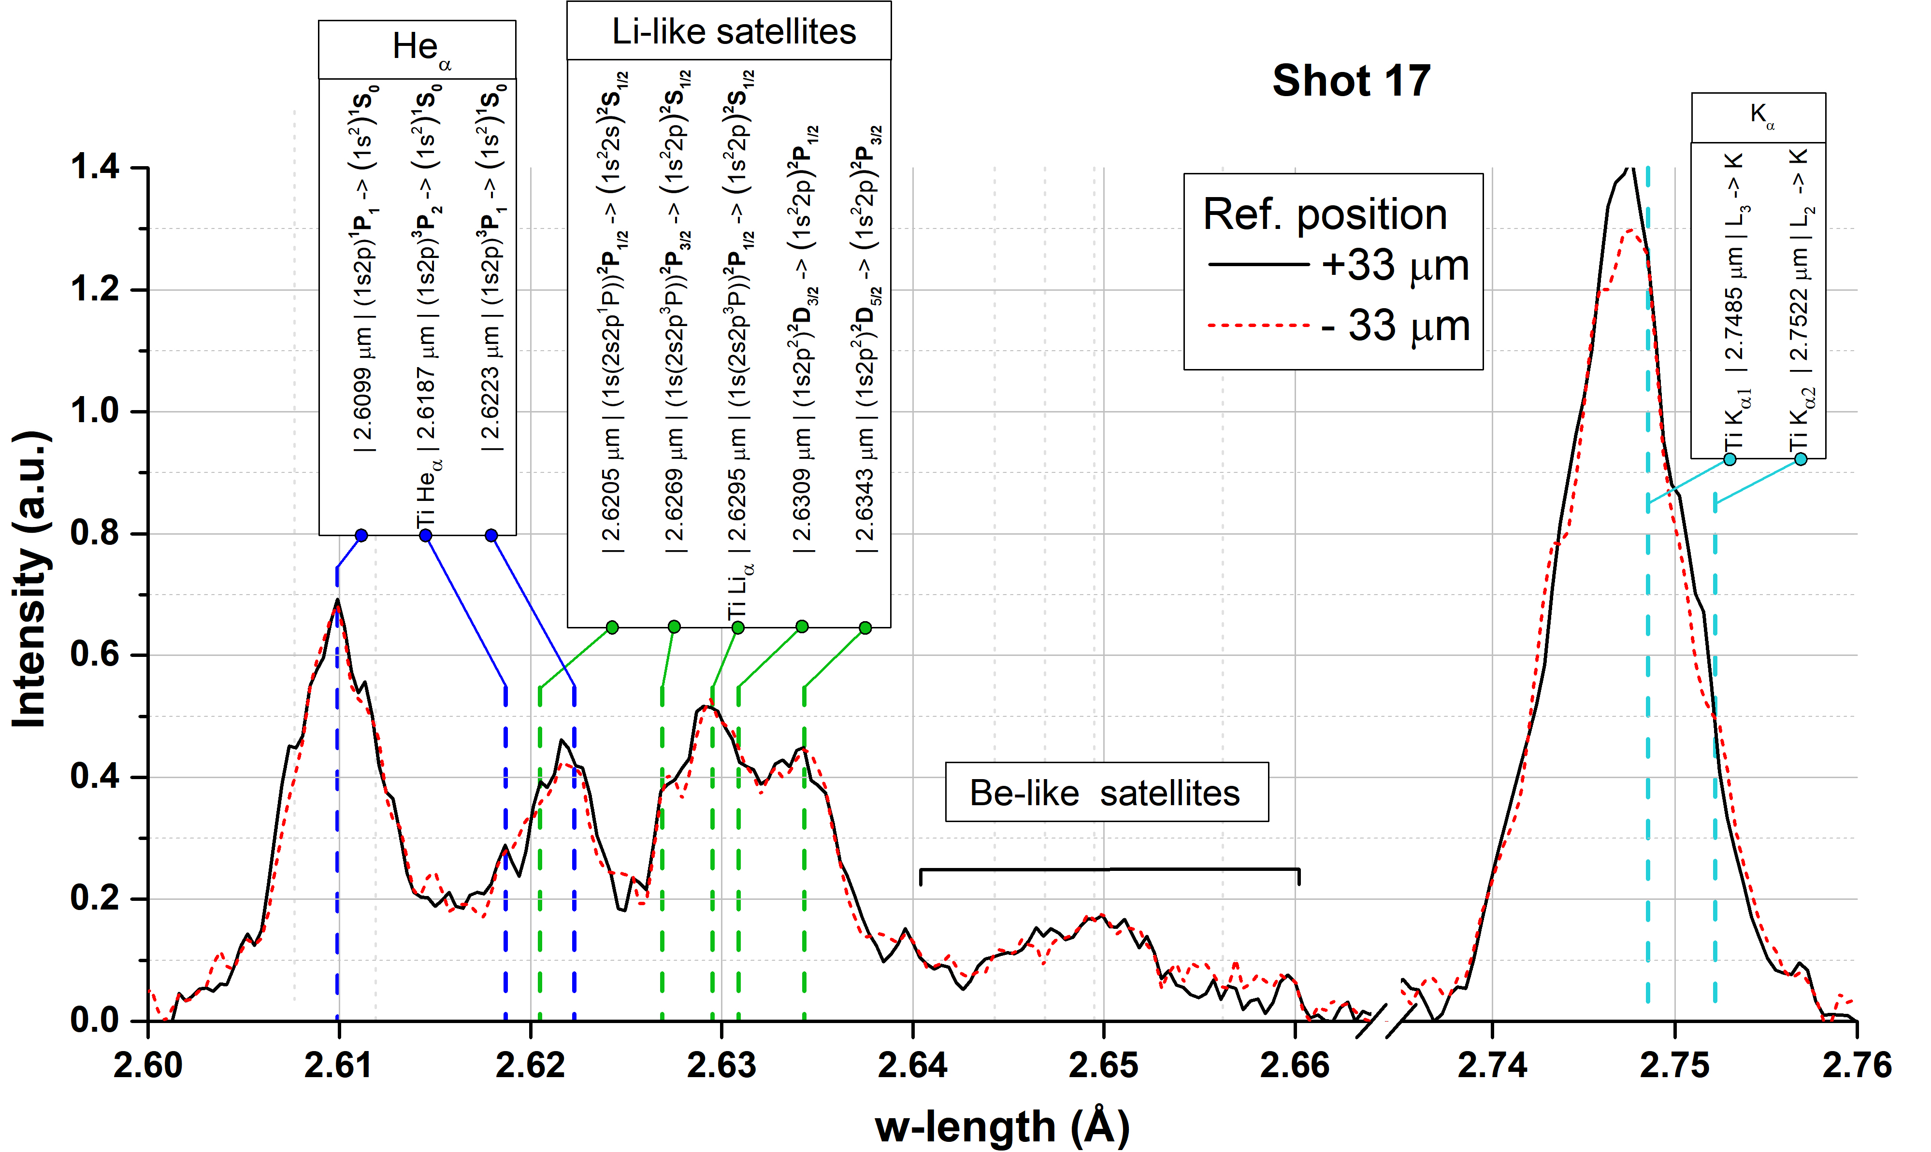
Experimental spectrum for -33 and +33 μm positions (near max of of He_{α} and K_{α}). Lines from http://spectr-w3.snz.ru.

Slide 8
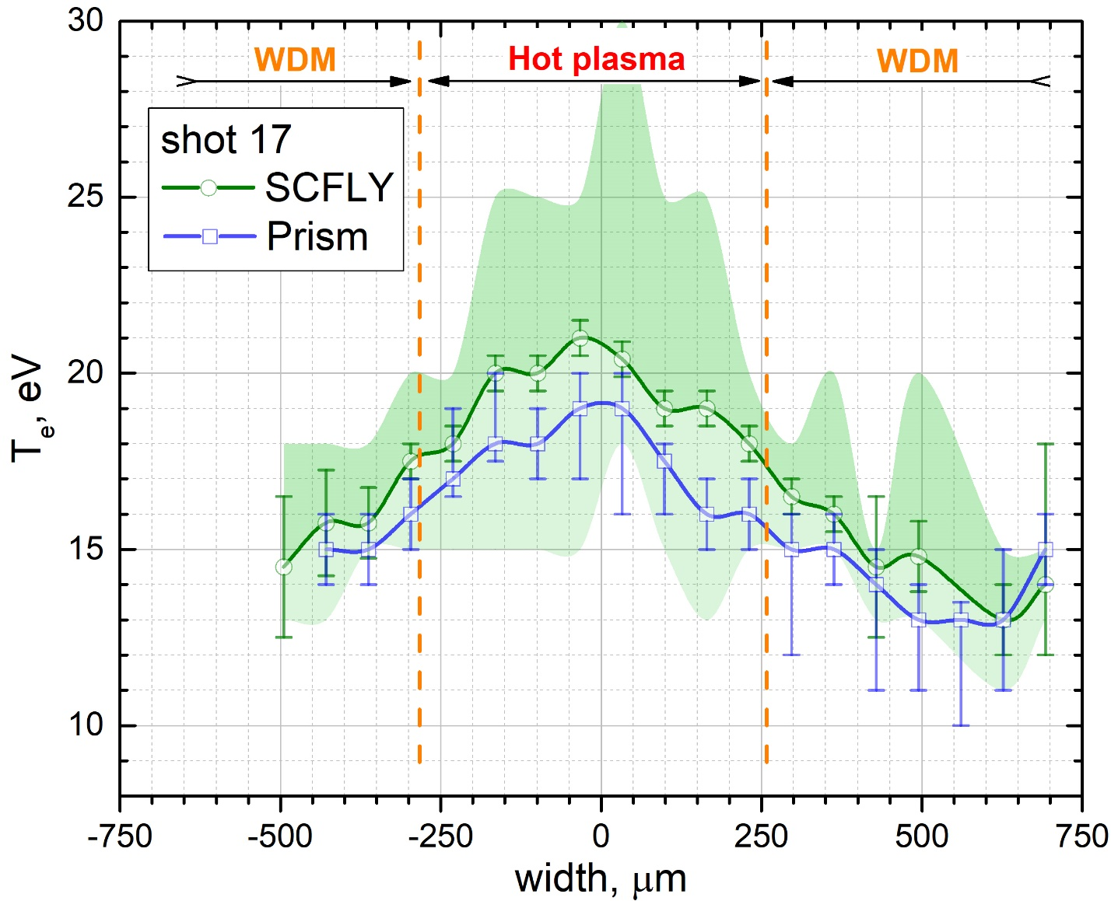
Estimated distribution of electron temperature of Ti as a function of width is on the picture.
Green field corresponds to energies which were taken for SCFLY estimation, for e.g., for point +33 μm were taken 18 eV (x0.8) and 35 eV (x0.2).
It’s supposed that SCFLY modelling results is more accurate than Prism one.

Slide 9
Part 3
He-alfa modelling grounds

Slide 10
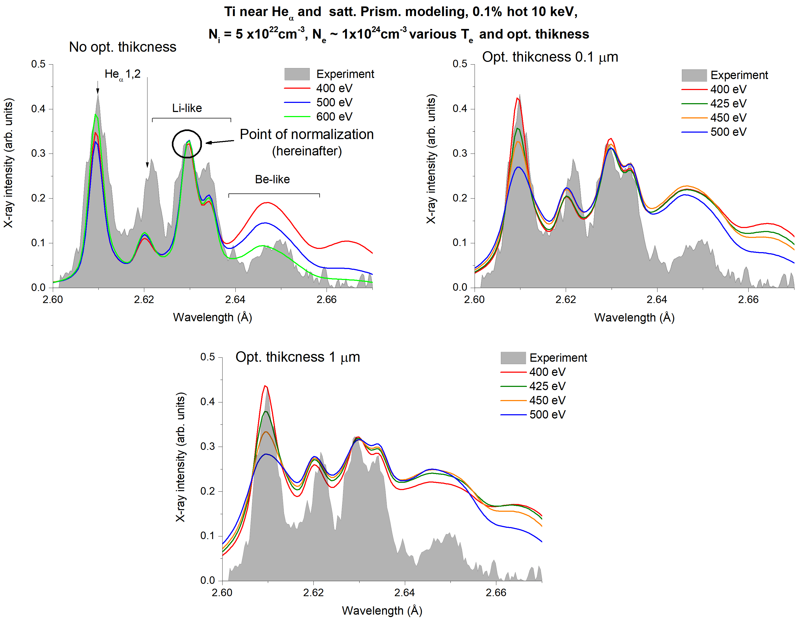
Lets start from the solid density, fix plasma density and hot electron parameters (temperature and fraction); temperature parameters 400-500 eV.
One can be seen that N_{i} = 5x10²²cm⁻³ doesn’t fit at any Т_{е} and plasma thickness.
Li-line is a point of normalization hereinafter.
Notes:
Graph27

Slide 11
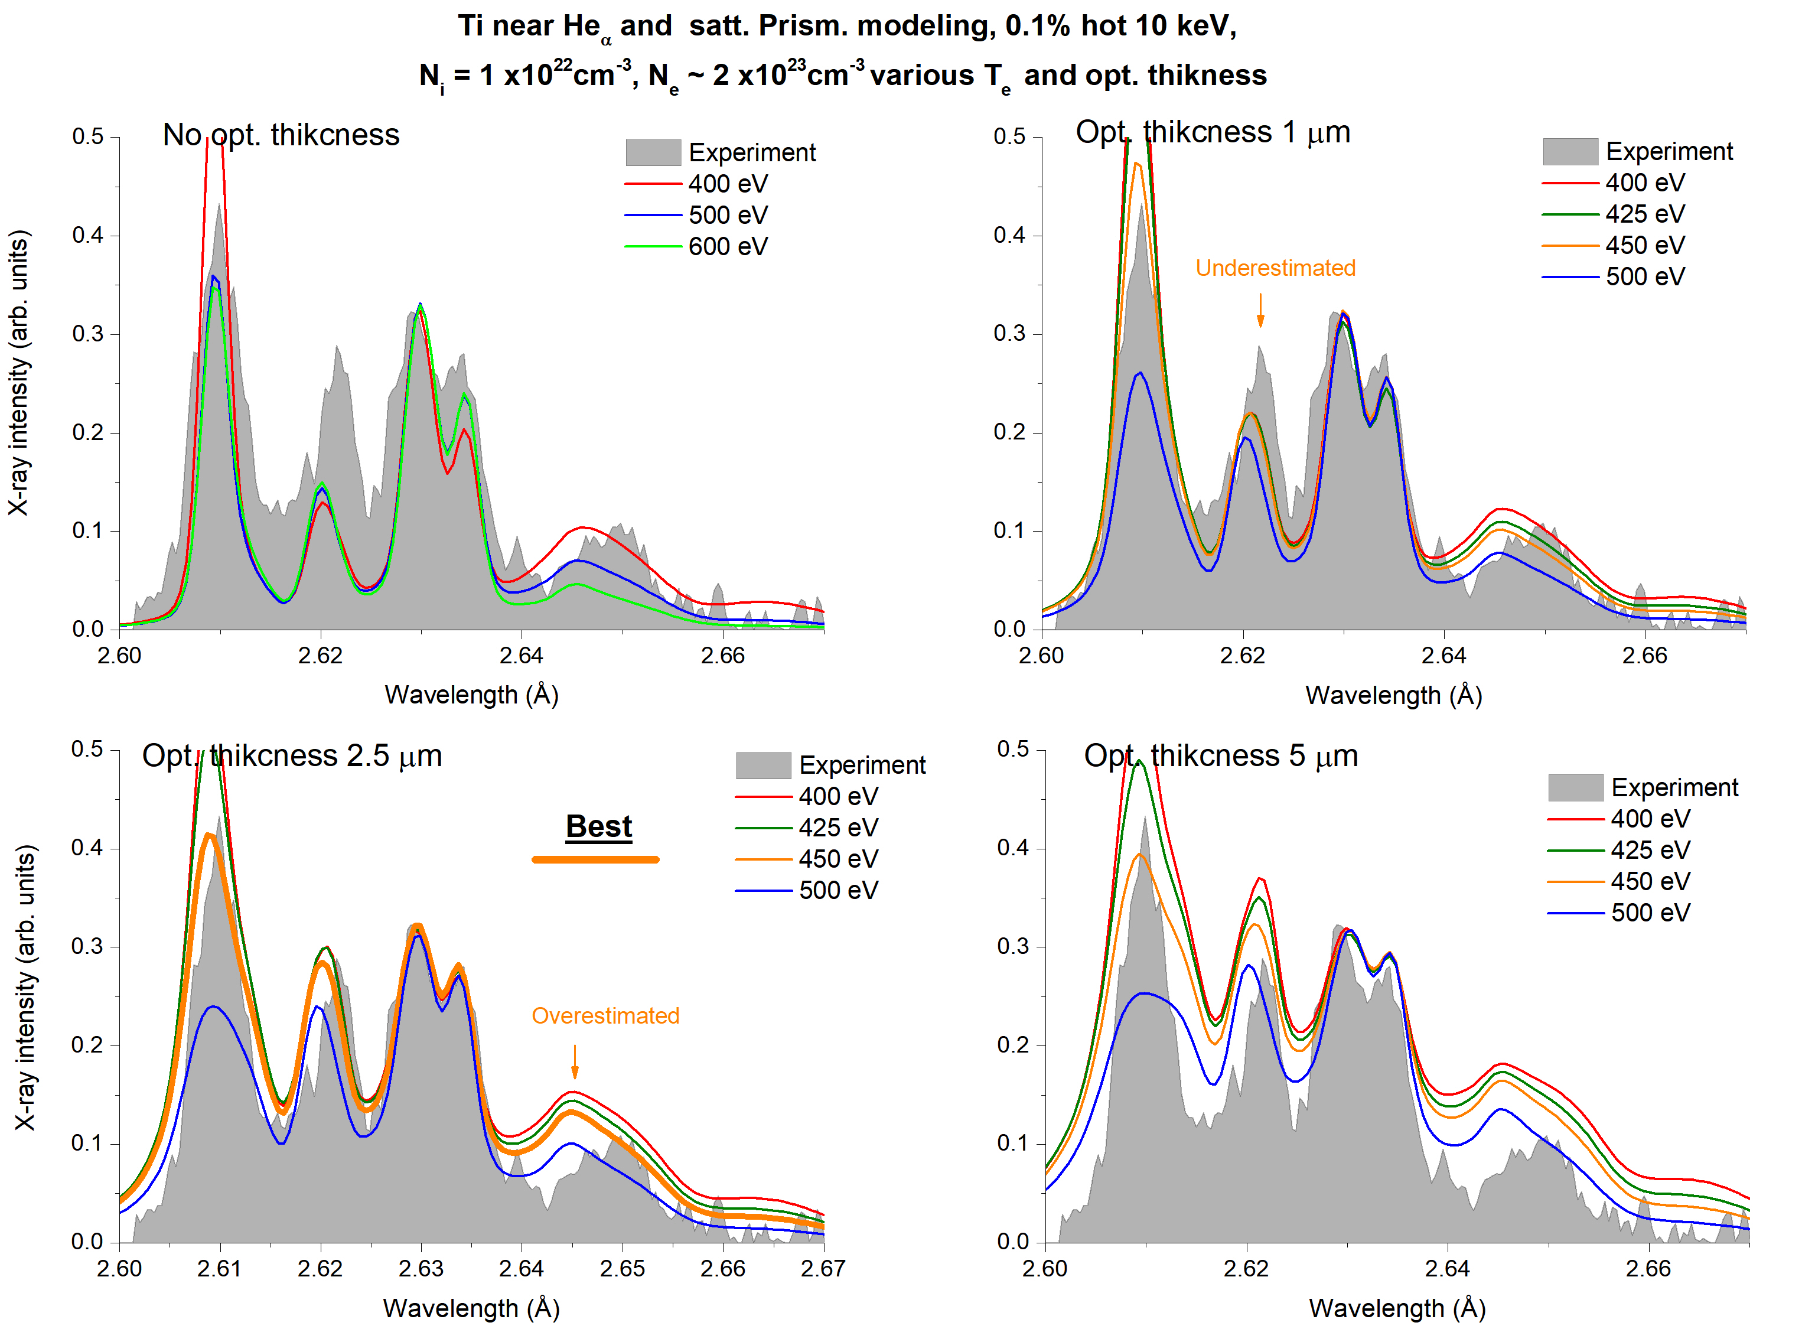
Further, let us consider N_{i} = 1x10²² cm⁻³.
One can be seen that experimental spectrum is fitted now with Т_{е} =450 эВ and plasma thickness 2.5 μm. But Ве-like satellites are bed overestimated.
That’s mean that lower density should be considered in modelling, but the temperature is about 400 eV.
Notes:
Graph26

Slide 12
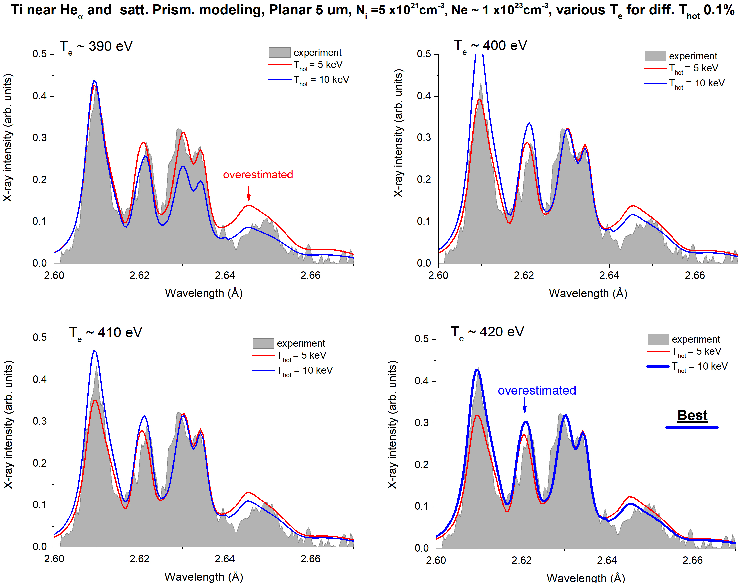
Further, let us consider Ni = 5x10²¹ cm⁻³.
Experimental spectrum can be fitted with Те =420 eV, 10 keV hot-e, 5 μm thickness in both cases). However, Li-like satellites is overestimated a little.
Curve for Те =390 eV, 5 keV hot-electron temperature parameters ai also well fit (Be-like sat. is overestimated in this case).
Notes:
Hot e-influence

Slide 13
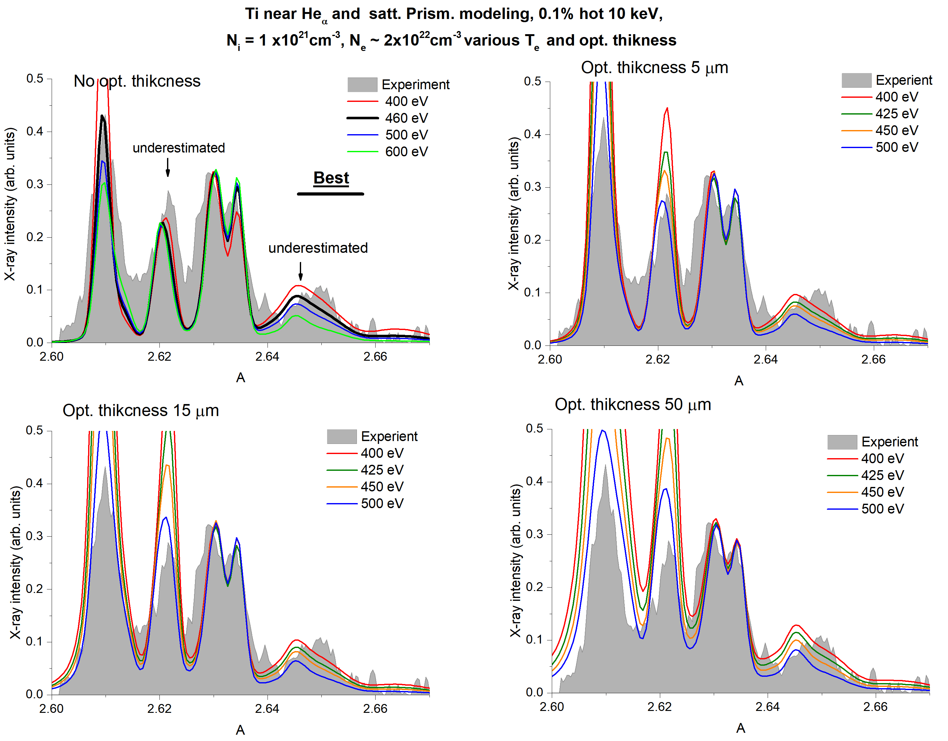
Further, let us consider Ni = 1x10²¹cm⁻³.
Now experimental spectrum can be fitted with zero optical plasma thickness and Те = 460 eV. But both Ве-like are and Li-like satellites are underestimated.
Model spectrum with lower plasma density value will not allow us to fit experimental one because of the Не_{α} lines relation and Be-like satellites intensities.
Variations of plasma temperature and optical density can’t improve fitting.
Notes:
Graph28

Slide 14
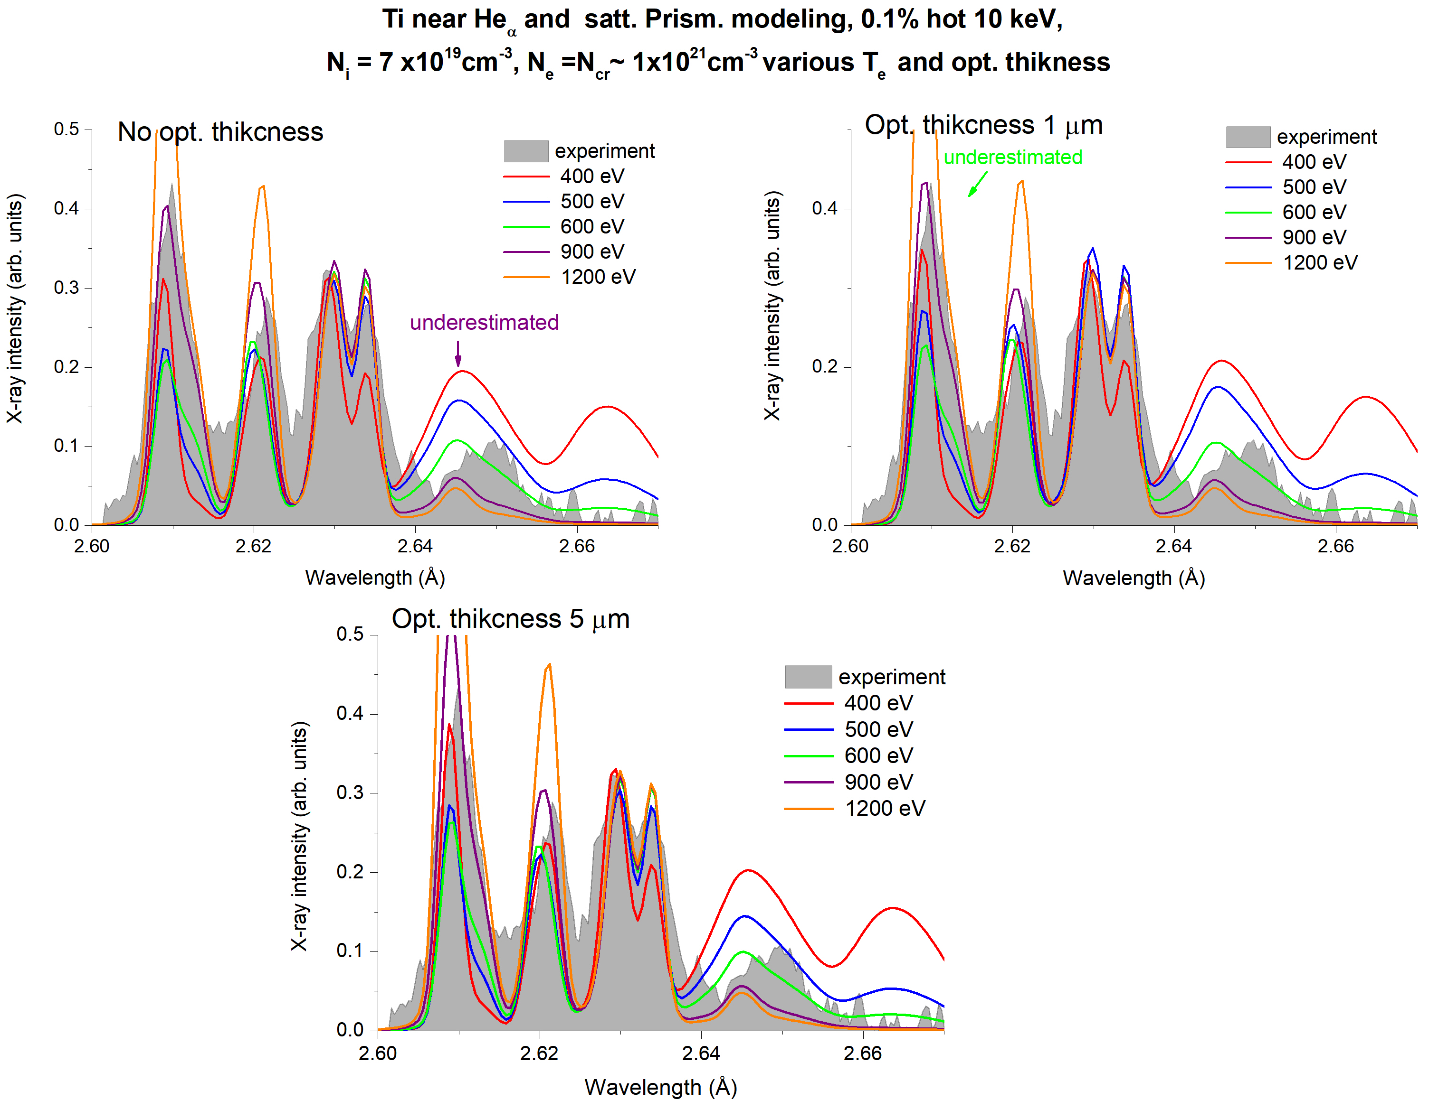
Pictures for a critical density case.
We can see that model spectrum with lower plasma density value is not able to fit experimental one because of the quite noticable unfitting of Не_{α} lines relation and Be-like satellites intensities.
Variations of plasma temperature and optical density can’t improve fitting.
Notes:
Graph30

Slide 15
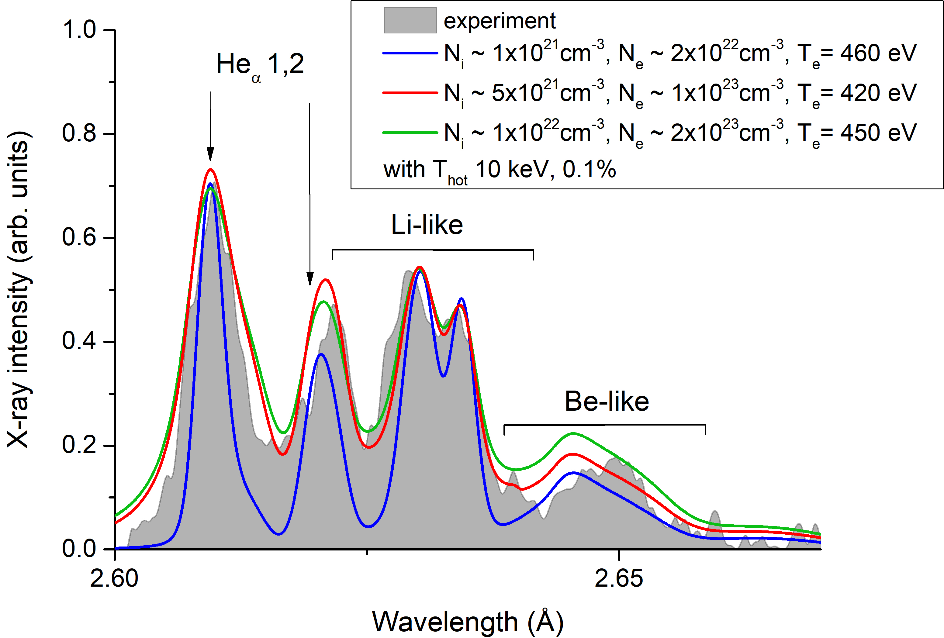
Those model spectra are the best ones in fitting the experimental curve for Shot 17.
That's mean that plasma parameters are the following:
N_{i} ~ 0.5(±0.3) x 10²¹ cm⁻³
N_{e} ~ 0.5(±0.3) x 10²² cm⁻³
Т_{е} ~ 440(±20) eV
Two different spectral lines databases were used: one for a calibration curve for the experimental curve (see slide 7) and the other for this modelling. Therefore (because of the difference in spectral lines wavelength there is a little horizontal shift between experimental and model spectra.
Notes:
Graph32

Slide 16
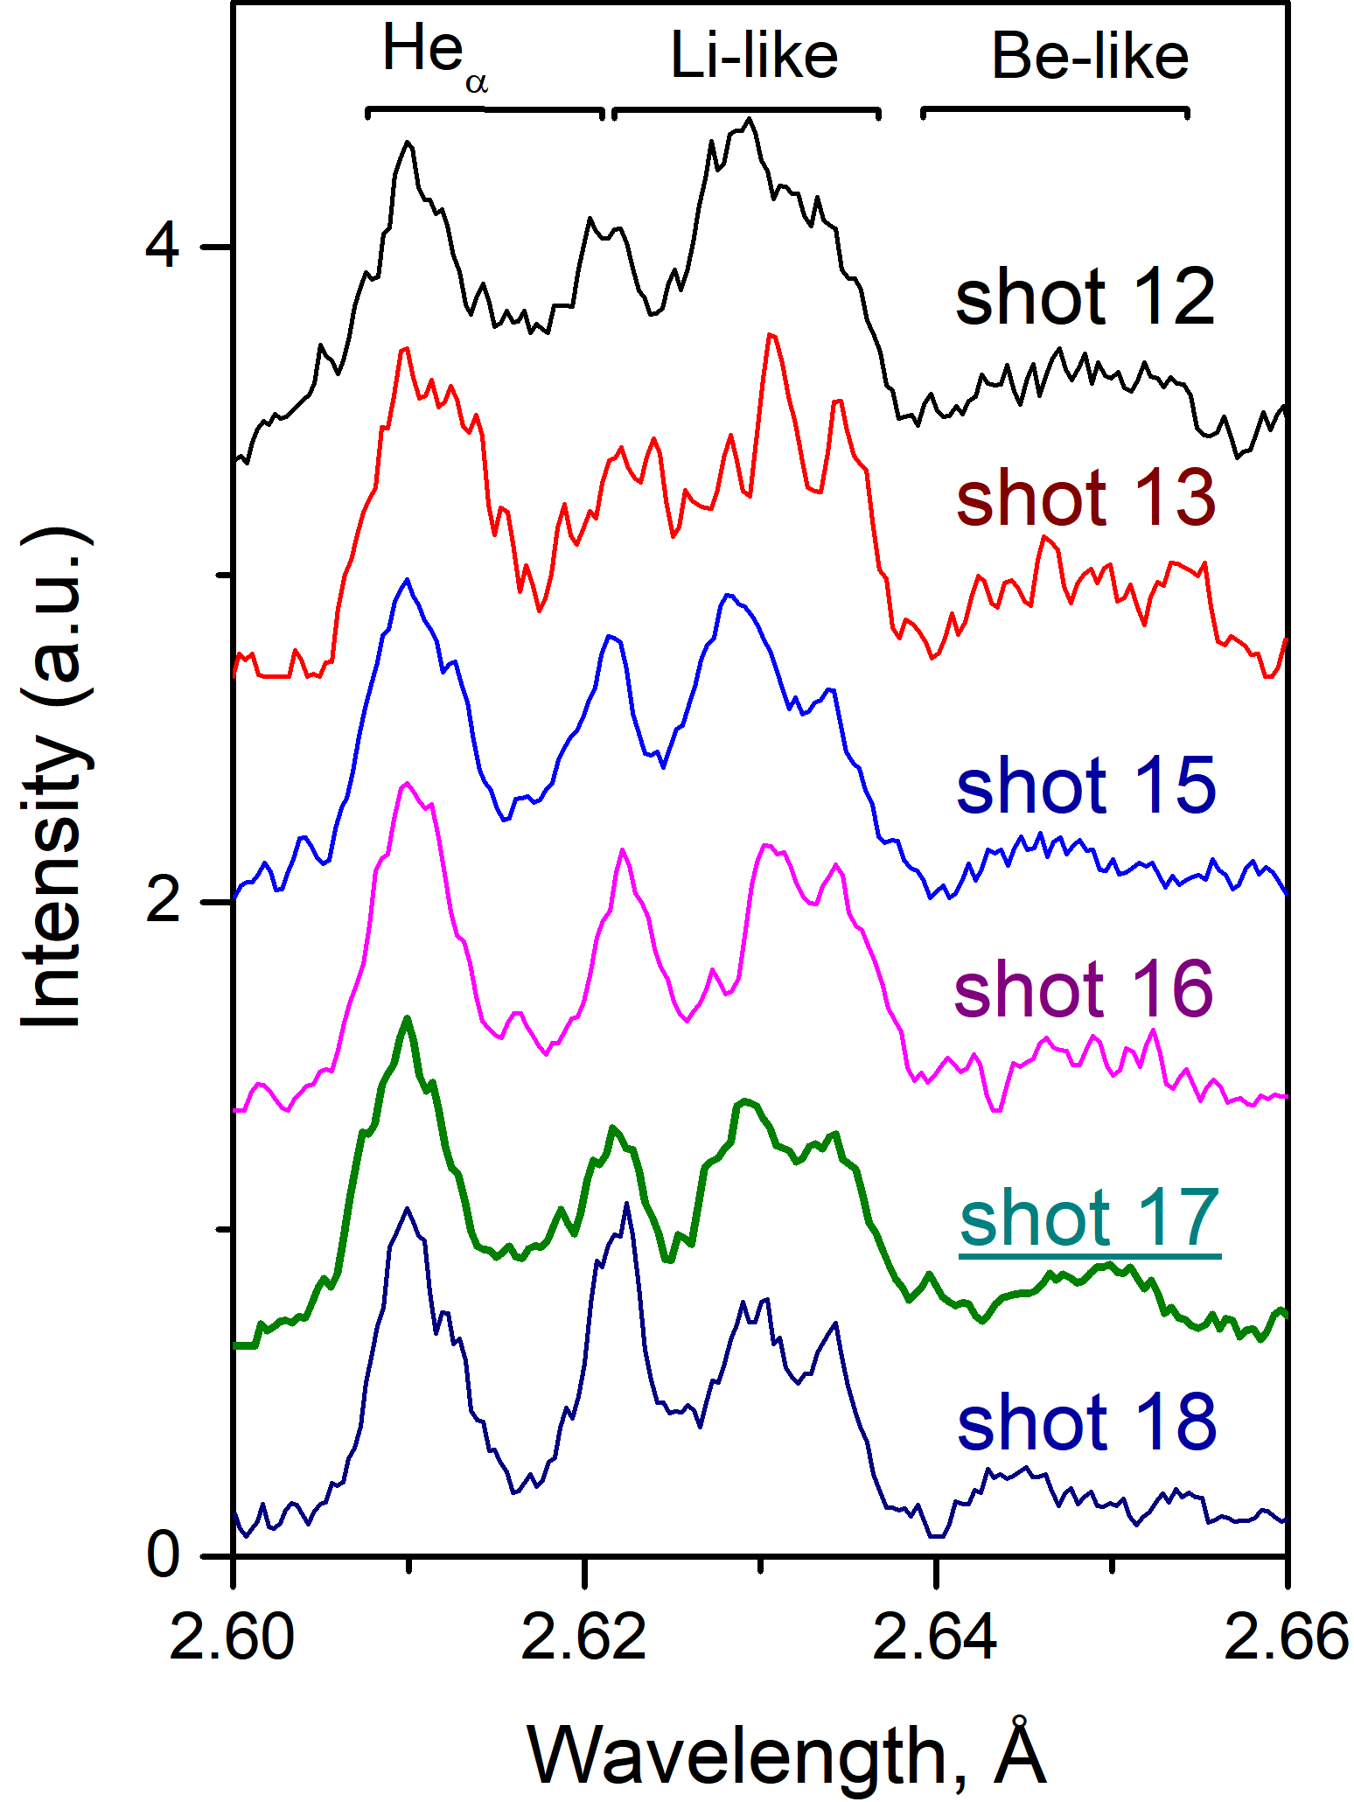
One can be noticed that Не_{α}, Li and Be spectrum group has more or less similar patterns (relative intensity, etc.), see the picture.
One can be assumed that plasma parameters for shot 17 estimated from the modelling is relatively correspond to other shots.
However,
- Spectral curves of shots 15, 16, 17 are more or less similar.
- Spectral curve of shots 13 corresponds to a lower plasma temperature energy than for shot 17 (probably, because of the lower laser contrast).
- Spectral curve of shots 18 corresponds to a lower plasma density than for shot 17.

